Slide 1
Pharmacokinetics

Slide 2
Pharmacokinetics
Pharmacokinetic processes include:-
Absorption: from the site of administration permits entry of the drug into plasma.
Distribution: the drug may then reversibly leave the bloodstream and distribute into the interstitial and intracellular fluids.

Slide 3
Metabolism: the drug may be biotransformed by metabolism by the liver or other tissues.
Elimination: the drug and its metabolites are eliminated from the body in urine, bile, or feces.

Slide 4
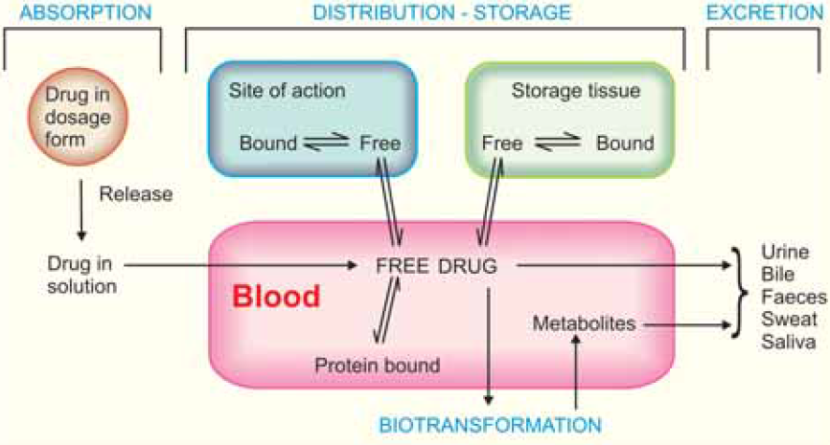

Slide 5
Absorption of drug
is the transfer of a drug from the site of administration to the bloodstream.
It depends on:
chemical characteristics of the drug:
Lipid soluble or non-lipid soluble.
route of administration: Routes other than intravenous may result in partial absorption and lower bioavailability.

Slide 6
Mechanisms of absorption of drug
passive diffusion facilitated diffusion
active transport endocytosis.
1. Passive diffusion: The driving force for passive absorption of a drug is the concentration gradient across a membrane separating two body compartments.

Slide 7
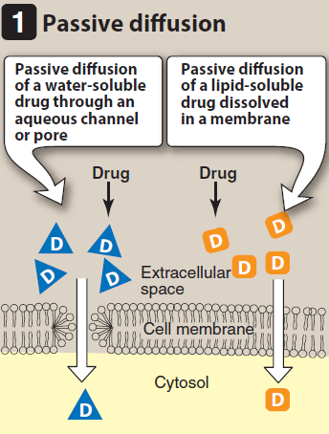

Slide 8
2. Facilitated diffusion
agents can enter the cell through specialized carrier proteins that facilitate the passage of large molecules.
These carriers allowing the passage of drugs or endogenous molecules into the interior of cells and moving them from an area of high conc. to an area of low conc.

Slide 9
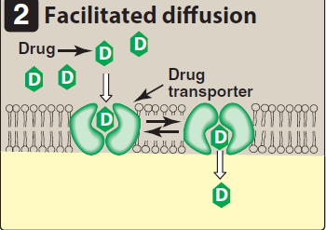

Slide 10
3. Active transport
involves specific carrier proteins. Energy-dependent, is driven by the hydrolysis of ATP. The process is saturable.
It is capable of moving drugs against a concentration gradient.
Active transport systems are selective.

Slide 11
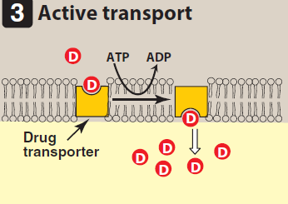

Slide 12
4. Endocytosis and exocytosis
transport drugs of exceptionally large size across the cell membrane.
Endocytosis involves engulfment of a drug by the cell membrane and transport into the cell by pinching off the drug-filled vesicle. Vitamin B12 is transported across the gut wall by endocytosis.

Slide 13
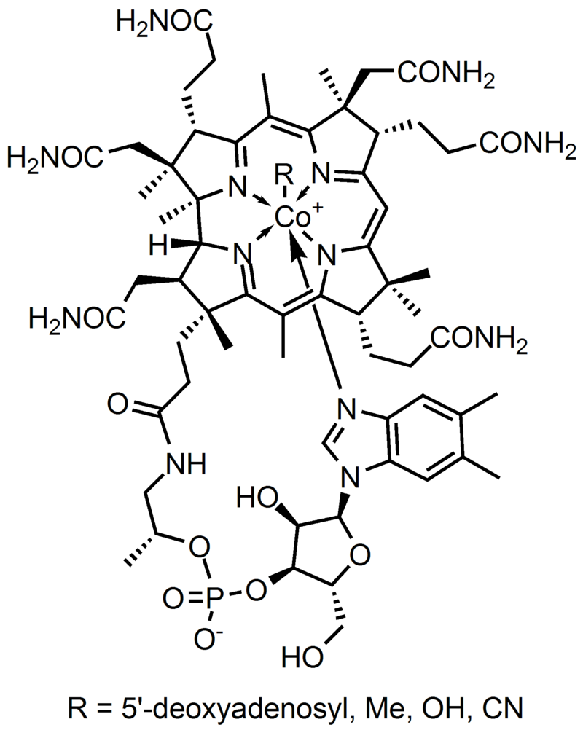

Slide 14
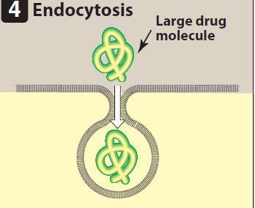

Slide 15
Exocytosis
is the reverse of endocytosis.
norepinephrine are stored in intracellular vesicles in the nerve terminal and released by exocytosis.

Slide 16
Bioavailability
Bioavailability is the fraction of unchanged drug reaching the systemic circulation
Its 100% for intravenous drugs.
oral drug bioavailability is less than 100%:
incomplete extent of absorption across the gut wall.
first-pass elimination by the liver.

Slide 18
First-Pass Elimination
Following absorption across the gut wall, the portal blood delivers the drug to the liver prior to entry into the systemic circulation.
First pass hepatic metabolism reduce the drug bioavailability.

Slide 19
the liver can excrete the drug into the bile. the overall process is known as first-pass elimination.
more than 90% of nitroglycerin is cleared during first-pass metabolism, so it is administered via the sublingual or transdermal route.

Slide 20
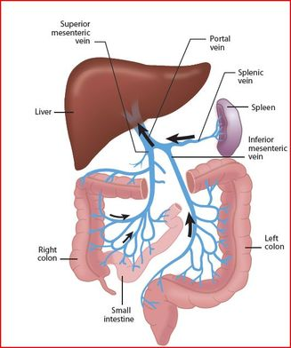

Slide 21
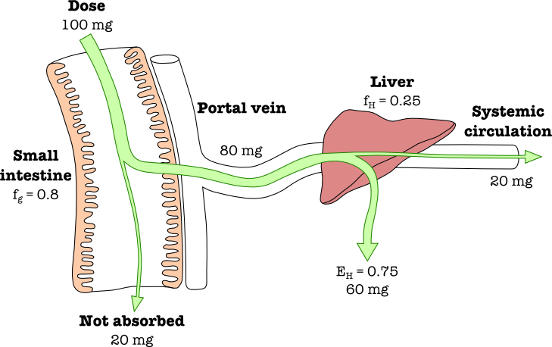

Slide 22
Low: Theophylline, Phenobarbitone.
Intermediate: aspirine, metoprolol.
High:
given orally with high dose as , Morphine, Salbutamol.
Not given orally as hydrocortisone, lidocaine.

Slide 23
Drug distribution
Is drug movement from the bloodstream to the interstitium (extracellular fluid) and the tissues. depends on:
cardiac output and local blood flow.
capillary permeability.
drug binding to plasma and tissue proteins.
the relative lipophilicity of the drug.

Slide 24
Blood flow:
brain, liver, and kidney greater than that to the skeletal muscles. Adipose tissue, skin, and viscera have still lower rates of blood flow.
High blood flow, together with high lipophilicity of propofol, permits rapid distribution into the CNS and produces anesthesia.

Slide 25
B. Capillary permeability:
In the liver and spleen, slit junctions between Capillary endothelial cells permit passage of even large plasma proteins.
In the brain capillary endothelium there are no slit junctions. To enter the brain, drugs must pass through the endothelial cells of the CNS capillaries or be actively transported.

Slide 26
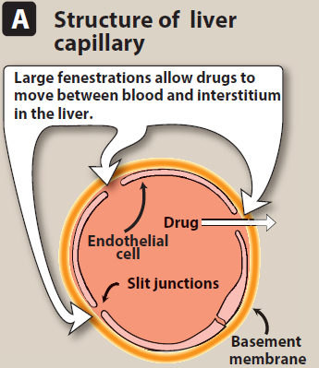
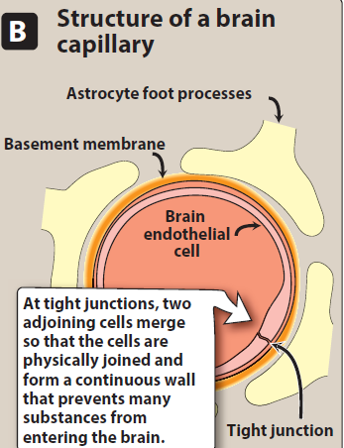

Slide 27
Lipid-soluble drugs readily penetrate the CNS because they dissolve in the endothelial cell membrane.
Ionized or polar drugs generally fail to enter the CNS because they cannot pass through the endothelial cells that have no slit junctions.

Slide 28
Binding of drugs to plasma proteins and tissues:
Binding to plasma proteins:
binding to plasma proteins sequesters drugs in a nondiffusible form and slows their transfer out of the vascular compartment.
Albumin is the major drug-binding protein and may act as a drug reservoir.

Slide 29
2. Binding to tissue proteins:
accumulation in tissues, lead to higher conc. in tissues than in the extracellular fluid and blood.
Tissue serve as a major source of the drug and prolong its actions or cause local drug toxicity.
acrolein, themetabolite of cyclophosphamide, can cause hemorrhagic cystitis because it accumulates in the bladder.

Slide 30

Volume of distribution
the fluid volume that is required to contain the entire drug in the body at the same concentration measured in the plasma.

Slide 31
If a drug has a large Vd , most of the drug is in the extraplasmic space and is unavailable to the excretory organs (liver, kidney).
any factor that increases Vd can increase the half-life.

Slide 32
drug of high molecular weight, extensively protein bound, is effectively trapped within the plasma (vascular) compartment and has a low Vd that approximates the plasma volume or about 4 L in a 70-kg individual. Heparin shows this type of distribution.

Slide 33
If a drug has a low molecular weight but is hydrophilic, it can pass through the endothelial slit junctions of the capillaries into the interstitial fluid.
these drugs distribute into a volume that is the sum of the plasma volume and the interstitial fluid, (14 L in a 70-kg individual).
Aminoglycoside antibiotics show this type of distribution.

Slide 34
If a drug has a low molecular weight and is lipophilic, it can move into the interstitium through the slit junctions and also pass through the cell membranes into the intracellular fluid. These drugs distribute into a volume of about 42 L in a 70-kg individual. Ethanol exhibits this apparent Vd.

Slide 35
Drugs biotransformation (Metabolism)
Biotransformation means chemical alteration of the drug in the body. It is needed to render nonpolar (lipid soluble) compounds polar (lipid insoluble) so that they are not reabsorbed in the renal tubules and are excreted.

Slide 36
Most hydrophilic drugs, e.g. gentamicin, neostigmine, etc. are not biotransformed and are excreted unchanged.
liver; others are—kidney, intestine, lungs and plasma.

Slide 37
Biotransformation of drugs may lead to the following :
1. Inactivation: Most drugs and their active metabolites are rendered inactive or less active, Ex. lidocaine, ibuprofen, paracetamol.

Slide 38
2. Active metabolite from an active drug: Many drugs have been found to be partially converted to one or more active metabolite ; the effects observed are the sum total of that due to the parent drug and its active metabolite(s).
Diazepam oxazepam
Codien to morphine

Slide 39
3. Activation of inactive drug : Few drugs are inactive and need conversion in the body to one or more active metabolite(s). Such a drug is called a prodrug. The prodrug may be more stable, having better bioavailability or other desirable pharmacokinetic properties or less side effects and toxicity. Some prodrugs are activated selectively at the site of action.
Ex. Levodopa Dopamine
Enalapril Enalaprilat

Slide 40
metabolized into more polar (hydrophilic) substances in the liver via two general sets of reactions:
Nonsynthetic, Phase I reactions:
functional group may begenerated/exposed. metabolite may be active or inactive.
B. Synthetic/Conjugation/ Phase II reactions:
metabolite is mostly inactive except few drugs, e.g. morphine-6-glucuronide.

Slide 41
A. Nonsynthetic, Phase I reactions
The phase I reactions most frequently involved in drug metabolism are catalyzed by the cytochrome P450 system wich is important for the metabolism of many endogenous compounds (such as steroids, lipids) and for the biotransformation of exogenous substances (xenobiotics).

Slide 42
Phase I reactions convert lipophilic drugs into more polar molecules by introducing or unmasking a polar functional group, such as –OH or –NH2. Phase I reactions usually involve reduction, oxidation, or hydrolysis.

Slide 43
Oxidation: Oxidations are the most important drug metabolizing Reactions that carried out by cytochrome P-450 system isoforms in the liver.
EX. Theophylline, steroids

Slide 44
2. Reduction: This reaction is the converse of oxidation and involves cytochrome P-450 enzymes working in the opposite direction.
EX. halothane and warfarin.
3. Hydrolysis: This is cleavage of drug molecule by taking up a molecule of water
Ester + H2O Acid + Alcohol
Ex. lidocaine, pethidine.

Slide 45
B. Phase II:
conjugation reaction with an endogenous substrate, such as glucuronic acid, sulfuric acid, acetic acid, or an amino acid, results in more polar, therapeutically inactive.
morphine-6-glucuronide, which is more potent than morphine.
Glucuronidation is the most common and the most important conjugation reaction.

Slide 46
Elimination
polar drugs eliminated from the body occurs via a number of routes, the most important being elimination through the kidney into the urine.
Patients with renal dysfunction may be unable to excrete drugs and are at risk for drug accumulation and adverse effects.

Slide 47
A. Renal elimination of a drug
Elimination of drugs via the kidneys into urine involves the processes of glomerular filtration, active tubular secretion, and passive tubular reabsorption.
1. Glomerular filtration: Free drug flows through the glomerular capillary slits into the Bowman space as part of the glomerular filtrate.

Slide 48
2. Proximal tubular secretion:
occurs in the proximal tubules by two energy-requiring active transport systems: one for anions and one for cations.
low specificity and can transport many compounds. Thus, competition between drugs for these carriers can occur within each transport system.

Slide 49
3. Distal tubular reabsorption:
uncharged drug diffuse out of the nephric lumen, back into the systemic circulation.
urine pH alteration increase the fraction of ionized drug in the lumen to increase the clearance of an undesirable drug.
weak acids alkalinization of the urine
weak bases acidification of the urine.

Slide 50
Plasma half-life: The plasma half-life (t½) of a drug is the time taken for its plasma concentration to be reduced to half of its original value.
Ex. Metronidazole 8 hr.
Amoxicilline 2 hr.

Slide 51
Clearance (CL) : The clearance of a drug is the theoretical volume of plasma from which the drug is completely removed in unit time. It can be calculated as :-

Slide 52
Kinetics of elimination
First order (exponential) kinetics:
The rate of elimination is directly proportional to drug concentration, or a constant fraction of the drug present in the body is eliminated in unit time.
plasma half-life (t½) remains constant because V_{d} and CL do not change with dose.

Slide 53
Zero order (linear) kinetics:
aspirin, theophylline, the doses are very large and saturate eliminating mechanisms so the rate of elimination remains constant irrespective of drug concentration.
a constant amount of the drug is eliminated in unit time.
In Zero order kinetics—t½ increases with dose.

Slide 54
Design of dosage regimen
achievement and maintaining concentrations within a therapeutic response window while minimizing side effects is a goal.
small therapeutic window (digoxin, warfarin), extra caution in selecting a dosage regimen,
monitoring of drug levels may help ensure attainment of the therapeutic range.

Slide 55
When a drug is repeated at relatively short intervals, the plasma concentration rises and accumulates in the body until a steady state plasma concentration (Cpss) (rate drug elimination equals rate of drug administration) is reached (elimination balances input).

Slide 56
Time required to reach the steady-state drug concentration:
The concentration of a drug rises from zero at the start of the infusion to its ultimate steady-state level, Css. The rate constant for attainment of steady state is the rate constant for total body elimination of the drug.

Slide 57
Thus, 50% of Css of a drug is observed after the time elapsed, since the infusion, t, is equal to t1/2, where t1/2 (or half-life) is the time required for the drug concentration to change by 50%.

Slide 58
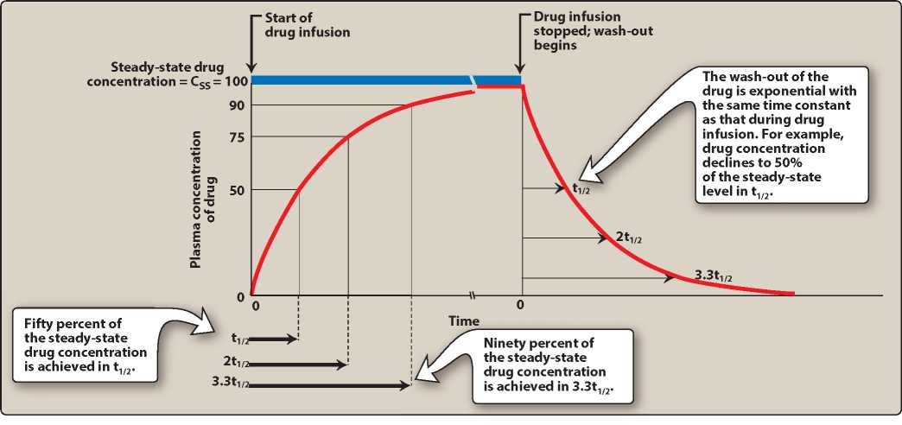

Slide 59
Multiple oral administrations:
Oral drugs taken at a specific dose one, two, or three times daily.
The fluctuations in plasma concentration at steady state depends on the dose interval relative to t½.
Dosage intervals are the result between what amplitude of fluctuations is clinically acceptable and what frequency of dosing is convenient.

Slide 60
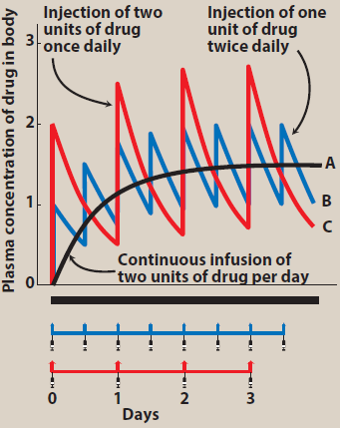

Slide 61
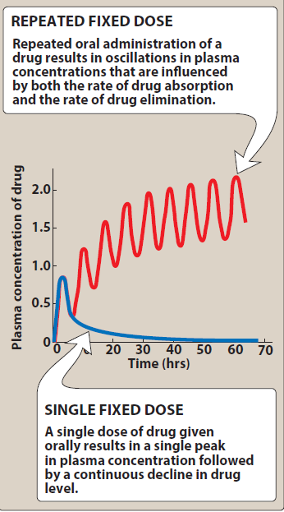

Slide 62
Drugs with short t½ (up to 2–3 hr) administered at intervals (6–12 hr) achieve the target levels only intermittently and fluctuations in plasma concentration are marked.
In case of many drugs (penicillin, ampicillin, chloramphenicol, erythromycin, propranolol) this is therapeutically acceptable.

Slide 63
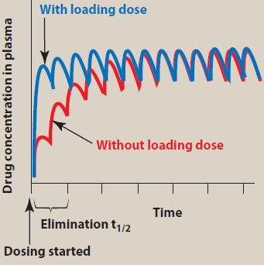

Slide 64
For drugs with longer t½ the attainment of target level at steady state will be delayed and so the therabutic effect by about 4 halflives. Such drugs are administered by initial loading dose and subsequent maintenance doses.

Slide 65
Maintenance dose: The dosing rate can be determined by knowing the target concentration in plasma (Cp), clearance (CL) of the drug from the systemic circulation, and the fraction (F) absorbed (bioavailability):

Slide 66
2. Loading dose: when a rapid obtainment of desired plasma levels is needed ( in serious infections). “loading dose” of drug is administered to achieve the desired plasma level rapidly, followed by a maintenance dose to maintain the steady state, as :
Loading dose = (Vd) × (desired Cpss)/F

Slide 67
For IV infusion, the bioavailability is 100%, and the equation becomes:-
Loading dose = (Vd) × (desired Cpss)

Slide 68
Development and regulation of drugs
the discovery or synthesis of a potential new drug compound or the elucidation of a new drug target is followed by subsequent steps to understand the drug’s interactions with its biologic targets. this approach leads to compounds with increased efficacy, potency, and selectivity. biologic effects, drug metabolism, pharmacokinetic profiles, and particularly an assessment of the relative safety of the drug must be characterized in vivo in animals before human drug trials can be started.
Most new drugs or drug products are discovered or developed through the following approaches:
(1) identification of a new drug target.
(2) rational design of a new molecule based on an understanding of biologic mechanisms and drug receptor structure;
(3) screening for biologic activity of large numbers of natural products, banks of previously discovered chemical entities, or large libraries of peptides, nucleic acids, and other organic molecules; and
(4) chemical modification of a known active molecule.
Drug Screening in animals
during drug screening study, many assays are performed in animals as rabbits, mice to determine the activity and selectivity of the drug, this include the drug action at the molecular, cellular, organ, system, and whole animal levels. The study is carried out in animal model of human disease.

Slide 69
Preclinical safety and toxicity testing
drugs that pass the initial screening study must be evaluated for potential risks before and during clinical testing. Preclinical toxicity testing includes acute and chronic toxicities, Effect on reproductive performance, Carcinogenic potential. The goals of preclinical toxicity studies include identifying potential human toxicities, and predicting the most relevant toxicities to be monitored in clinical trials.
several quantitative estimates are desirable; these include :-
no effect dose :- the maximum dose at which a specified toxic effect is not seen.
minimum lethal dose :- the smallest dose that is observed to kill any experimental animal.
median lethal dose (LD 50 ) :- the dose that kills approximately 50% of the animals.
These doses are used to calculate the initial dose to be tried in humans, usually taken as one hundredth to one tenth of the no-effect dose in animal.
Evaluation in human
Testing in humans is begun only after sufficient acute animal toxicity studies have been completed. Chronic safety testing in animals, including carcinogenicity studies, is usually done concurrently with clinical trial. Based on ethical principles, volunteers or patients must be informed of the investigational status of the drug as well as the possible risks. three formal phases of clinical trials before permission the drug marketing and one postmarking phase of clinical trial are carried out.
Phase 1 :- drug effects are studied in a small number (20–100) of healthy volunteers. Phase 1 trials are done to determine the limits of the safe clinical dosage range. If the drug is expected to have significant toxicity, as cancer and AIDS therapy, volunteer patients with the disease are used in phase 1. These trials may be nonblind or “open”; that is, both the investigators and the subjects know what is being given. Alternatively, they may be “blinded” and placebo controlled. Pharmacokinetic measurements of absorption, half-life, and metabolism are often done.
Phase 2 :- the drug is studied in patients with the target disease to determine its efficacy. A modest number of patients (100–200) are studied in detail. A single-blind design may be used, with an inert placebo medication and an established active drug (positive control) in addition to the investigational agent. Phase 2 trials have the highest rate of drug failures, and only 25% of innovative drugs move on to phase 3.
Phase 3 :- , the drug is evaluated in much larger numbers of patients with the target disease usually thousands to further establish and confirm safety and efficacy. phase 3

Slide 70
trials are designed to minimize errors caused by placebo effects, variable course of the disease, etc. Therefore, double-blind and crossover techniques are often used. If phase 3 results meet expectations, application is made for permission to market the new agent.
Phase 4 :- Once approval to market a drug has been obtained, phase 4 begins. This constitutes monitoring the safety of the new drug under actual conditions of use in large numbers of patients. The importance of careful and complete reporting of toxicity by physicians after marketing begins can be appreciated by noting that many important drug-induced effects have an incidence of 1 in 10,000 or less and that some adverse effects may become apparent only after chronic dosing. The sample size required to disclose drug-induced events or toxicities is very large for such rare events.

